Slide 1

IPL 2008-202
IPL DATA ANALYSIS

Slide 2
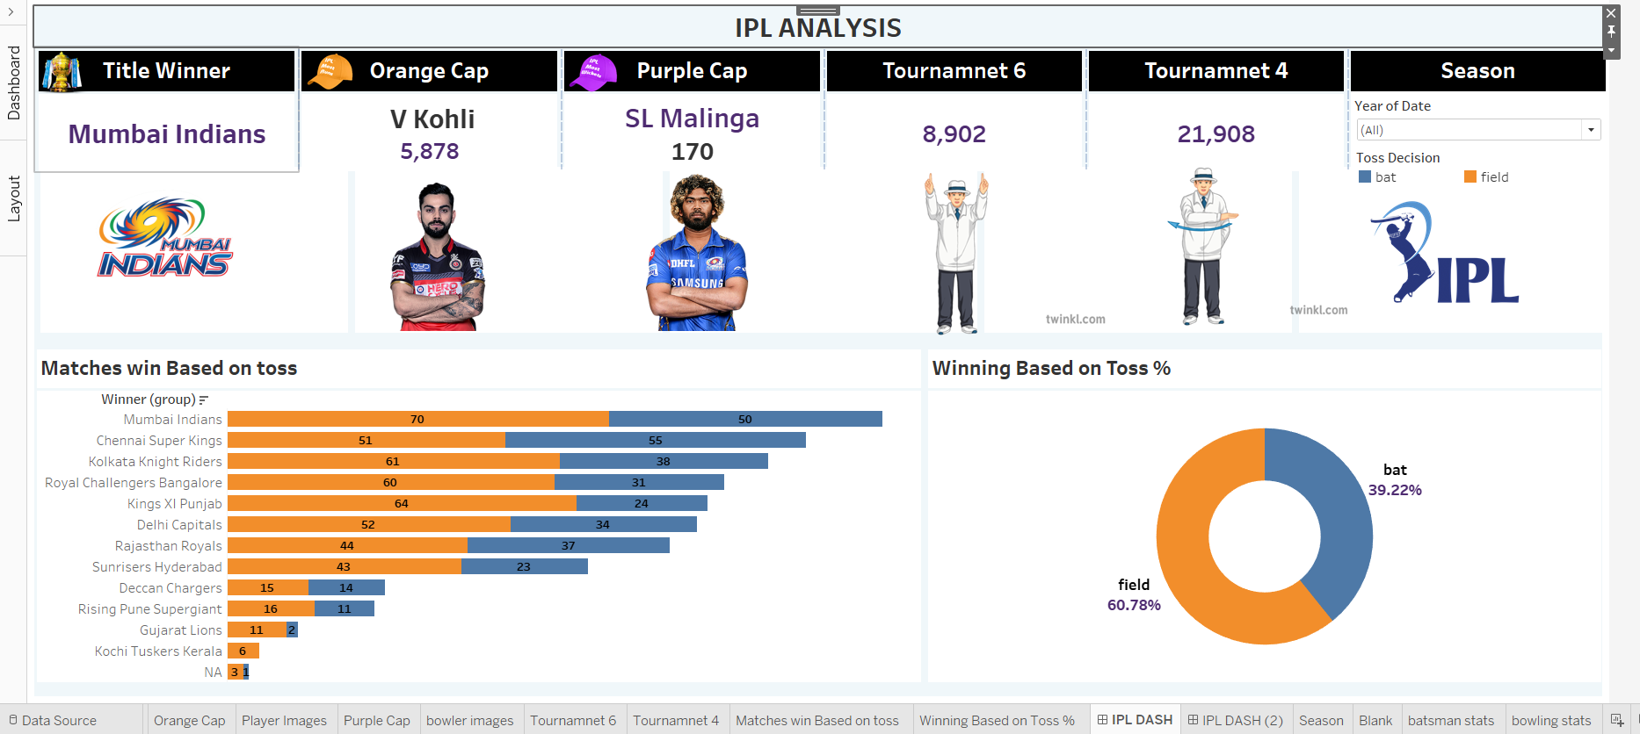

Slide 3
